Slide 1


COLLEGE OF ENGINEERING & TECHNOLOGY
MINI PROJECT
EVEN SEMESTER 23-24
“LUNG CANCER DETECTION ”
PRESENTED BY
MOHANA ACHUTHAN.B(20530)(510620205030)
SUHAIL.S(20546)(510620205046).

Slide 2
AGENDA
Abstract
Introduction
Objective
Software requirements
Existing
Propose
Modules until
System design
Conclusion

Slide 3
ABSTRACT
Cancer is one of the main reason for loss of human life across the world. All the medical practitioners and researchers are dealing with the demanding situations to fight against cancer. Based on the report in 2019 from American Cancer Society, 96,480 deaths are anticipated due to skin cancers, 142,670 deaths are from lung cancers, 42,260 deaths are from breast cancers, 31,620 deaths are from prostate cancers, and 17,760 deaths are from mind cancers. Initial detection of most cancers has the pinnacle precedence for saving the lives. So it is important to detect the lung cancer as to give proper medical treatments. This paper proposed a lung cancer detection using Deep Learning based on CNN Algorithm. Deep learning is used for detection and it is an efficient method used for image processing and pattern recognition. For Lung Cancer detection, Kaggle datasets taken from DICOM files of lung cancer patients are used for detection. Since the data provided by the CT scans of patients involves complicated pre-processing methods in order to get into the form that is usable to apply deep learning methodologies to it. Convolutional Neural Network (CNN) is used to classify and detect nodules using these datasets. In this project, we apply deep learning algorithms to identify lung cancer and its presence without the need for several consultations from different doctors. Lung nodules are predicted on this data using the nodule detector by running on the CT scans as grids.

Slide 4
INTRODUCTION
Lung cancer is also called lung carcinoma. This is a kind of harmful lung tumor considered as unrestrained cell growth in lung tissues. This development spread outside the lung by the method of metastasis into neighboring tissue or additional parts of the body. It is one of the leading reasons for death worldwide and it is one of the deadliest cancers. There are several stages of lung cancer. Stages of a cancer refers to how extensively cancerous cells has metastasized. Stages 1 and 2 refers to cancers that are localized on lungs and later stages refers to cancers that have spread to other organs. Early detection of lung cancer significantly improves the chances for survival, but it is also more difficult to detect early stages of lung cancer as there are fewer symptoms. We will be using a binary classification problem to detect the presence of lung cancer in patient CT scans of lungs with and without early stage lung cancer. The aim is to use methods from computer vision and deep learning to detect lung cancer. Although many methods have been proposed for image classification, few of them focus on the classification of lung cancer type from CT images without biopsy. We use deep learning to identify lung cancer from CT images of patients. Convolutional Neural Networks(CNN) are used to build an accurate classifier. Dataset for detection is extracted from the kaggle. An accurate lung cancer classifier could speed up and reduce costs of lung cancer screening, allowing for more widespread early detection and improved survival.

Slide 5
OBJECTIVES
Aim of the project
The aim of this project is to develop an efficient algorithm to detect that the patient is having cancerous cells or not and it will also show that the patients cells are normal or abnormal. Lung cancer and its presence without the need for several consultations from different doctors. This leads to an earlier prediction of the presence of the disease and allows us to take prior actions immediately to avoid further consequences 1 in an effective and cheap manner avoiding human error rate. In this project lung cancer and its presence is determined
Scope of the project
The Scope of this project is to detect the cancerous cells by using Deep Learning algorithms and to predict that the person is suffering from cancer or not. And also to reduce the death counts of the people who are killed by lung cancer all over the world.

Slide 6
SOFTWARE AND HARDWARE REQUIREMENTS
SOFTWARE REQUIREMENTS:
Front end : python
Back end : php, mysql
PHP TOOLS:
xampp-win32-5.5.19-0-VC11

Slide 7
EXISTING:
existing structures in the lung images statistically. They
propose many techniques that attempt to fit the distribution of
intensity values in an image to a set of mathematical statistical
functions. Each function defines a class and the output of the
function defines the probability of an intensity value belonging
to it. This approach was used by Guo et al., who developed a
lung segmentation method using expectation-maximization
(EM) analysis in combination with morphological operations
[40]. After computing the image’s histogram, the authors apply
the (EM) algorithm to estimate the appropriate threshold value
for lung segmentation

Slide 8
PROPOSE:-
In this paper, we propose a methodology for automatic
lung cancer detection in PET/CT images. The methodology Overview of the proposed method
Image pre-processing methods were used to enhance the images. Morphological operators were applied to extract the lung regions from the pre-processed images. Haralick second order statistical texture features using GLCM were used for further classification of PET/CT images by FCM clustering.

Slide 9
DESIGN AND METHODOLOGIES
MODULE 1
Importing libraries and collecting the datasets and importing it.
MODULE 2
Data Preprocessing is performed to convert the raw data into the understandable format.
MODULE 3
Data Training is performed to train the model based on the dataset and then predict on new data.
MODULE 4
Data is validated according to the datasets and the result is produced in GUI for user.

Slide 10
MODULE 1
Step 1 : Importing all the required libraries.
Pandas: This library helps to load the data frame in a 2D array format and has multiple functions to perform analysis tasks in one go.
Matplotlib: This library is used to draw visualizations.
Sklearn: This module contains multiple libraries having pre-implemented functions to perform tasks from data preprocessing to model development and evaluation.
Tenserflow: This is an open-source library that is used for Machine Learning and Artificial intelligence and provides a range of functions to achieve complex functionalities with single lines of code.
Step 2 : Collecting the datasets from Kaggle.
Step 3: Importing the data from external sources

Slide 11
MODULE 2
Step 1 :
Dataset is collected from the images of dicom files.
Step 2 :
Average is calculated.
Step 3 :
Check if data labels are available in csv or not.
Step 4 :
Check the results of data preprocessing.

Slide 12
MODULE 3
Step 1 :
Take the numpy data and load it.
Step 2 :
Data is trained from the numpy data.
Step 3 :
Apply the CNN algorithm.
Step 4 :
Prediction is performed and the actual results will be displayed.

Slide 13
MODULE 4
Step 1 :
Data is validated.
Step 2 :
Outputs from the data validation is displayed on the screen according to the datasets and data training.
Step 3 :
Outputs are displayed in GUI Screen.

Slide 14
ARCHITECTURE DIAGRAM
SCAN IMAGES
APPLYING CNN ALGORITHM
PATIENT
DATA COLLECTION
CSV FILE
PATIENT ID
DATA PREPROCESSING
DATA VALIDATION
TEST THE OUTPUT
PATIENTS DETAIL’S
DATA TRAINING

Slide 15
DATA FLOW DIAGRAM
DATA COLLECTION
DATA IMPORTED
DATA TRAINING
DATA VALIDATION
GET THE OUTPUT
APPLYING ALGORITHM
DATA PREPROCESSING

Slide 16
ER DIAGRAM
PATIENT ID
PATIENT NAME
TEST THE OUTPUT
PATIENTS DATASETS
GET THE OUTPUT
PATIENT SCAN IMAGES
DATA VALIDATION
CT SCAN
DATA TRAINING
COLLECTION OF DATA
PRE PROCESS THE DATA

Slide 17
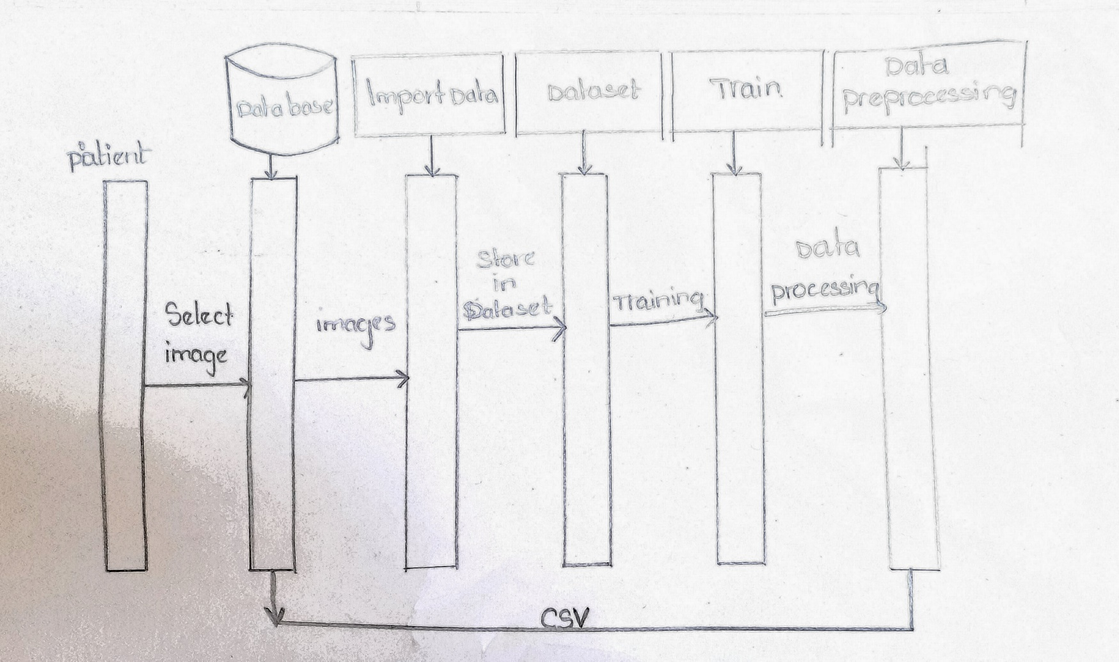
SEQUENCE DIAGRAM

Slide 18
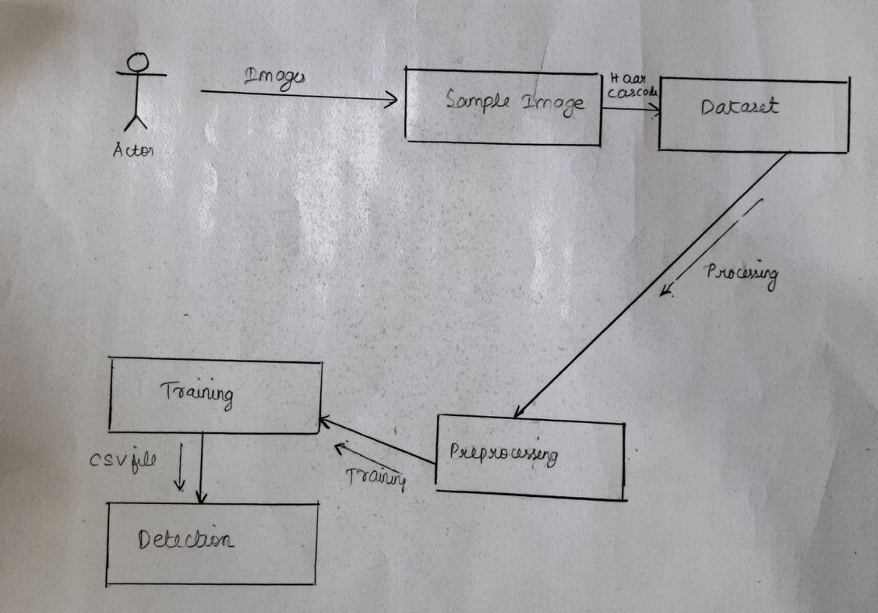
COLLABORATION DIAGRAM

Slide 19
TESTING
UNIT TESTING
Unit testing involves the design of test cases that validate that the internal program logic is functioning properly, and that program inputs produce valid outputs. All decision branches and internal code flow should be validated. It is the testing of individual software units of the application .it is done after the completion of an individual unit before integration. This is a structural testing, that relies on knowledge of its construction and is invasive. Unit tests perform basic tests at component level and test a specific business process, application, and or system configuration.

Slide 20
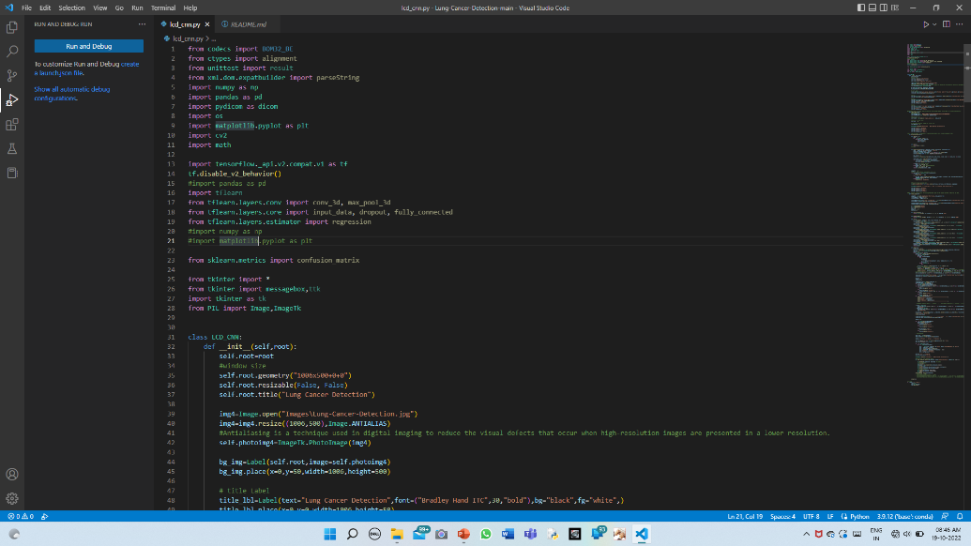
TESTING
INTEGRATION TESTING
Integration tests are designed to test integrated software components to determine if they actually run as one program. Testing is event driven and is more concerned with the basic outcome of screens or fields. Integration tests demonstrate that although the components were individually satisfaction, as shown by successfully unit testing, the combination of components is correct and consistent. Integration testing is specifically aimed at exposing the problems that arise from the combination of components.
Input testing :

Slide 21
TESTING
System Testing
System testing is a type of software testing that is performed on a complete integrated system to evaluate the compliance of the system with the corresponding requirements. In system testing, integration testing passed components are taken as input. The goal of integration testing is to detect any irregularity between the units hat are integrated together. System testing detects defects within both the integrated units and the whole system. The result of system testing is the observed behavior of a component or a system when it is tested. System Testing is carried out on the whole system in the context of either system requirement specifications or functional requirement specifications or in the context of both. System testing tests the design and behavior of the system and also the expectations of the customer.

Slide 22
TESTING
Functional Testing
Functional tests provide systematic demonstrations that functions tested are available as specified by the business and technical requirements, system documentation, and user manuals. Functional testing is centered on the following items: Valid Input-identified classes of valid input must be accepted. Invalid Inputidentified classes of invalid input must be rejected. Functions-identified functions must be exercised. Output-identified classes of application outputs must be exercised. Systems/Procedures: interfacing systems or procedures must be invoked. Organization and preparation of functional tests is focused on requirements, key functions.

Slide 23
CONCLUSION
In this system, we have implemented a detection method for lung cancer using deep learning based model developed using the CNN Algorithm and it showed high performance based on chest radiographs.
This detection method saves time and effort, and gives accurate results because we have used CNN algorithm, it differentiates the images and gives the reliable result according to the datasets and images.
This method aims to build an algorithm to classify and detect the cancerous cells and non cancerous cells.

Slide 24
Thank You

